Slide 1
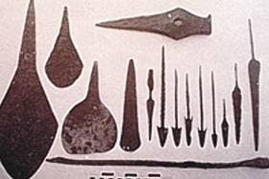
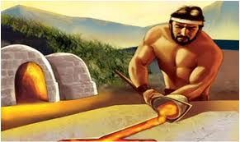
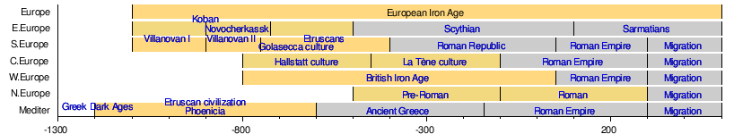
Unit 8: The Metal Age Introduction
At the end of the Neolithic era, people discovered metallurgy (extracting metal from ore)
3 Ages (transitions based on the metals they used and vary by place)
The Copper Age
The Bronze Age
The Iron Age

Slide 2
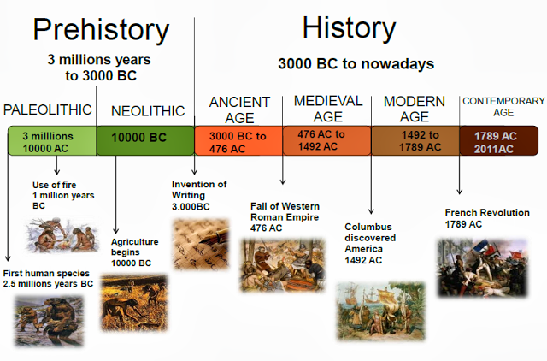
-The Iron Age is last in prehistory. Writing discovered 3500BC, beginning history.

Slide 3
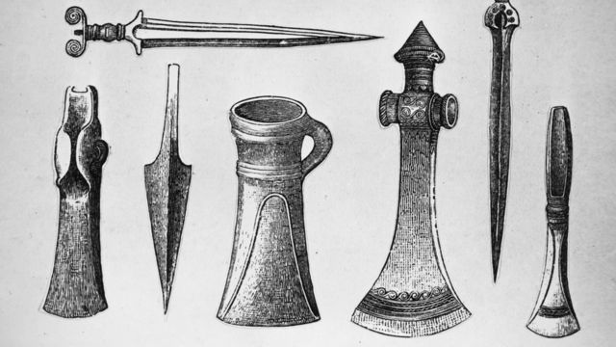
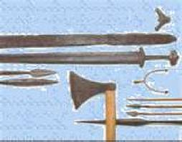
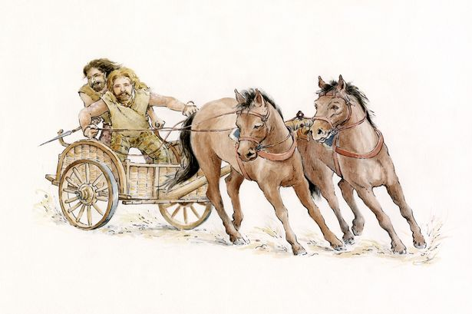
SOCIETY
METALLURGY CAUSED:
→ greater specialization of labor
→social differences (metal = symbol of wealth)
conflict + war caused by metal weapons: groups w/metal weapons dominated those w/out,
combats in horse-drawn chariots, people began to build walls around settlements
heavier farming tools + war = women stepped into the background, raising families
http://www.history.com/shows/mankind-the-story-of-all-of-us/videos/mankind-the-story-of-all-of-us-bronze (2min)

Slide 4
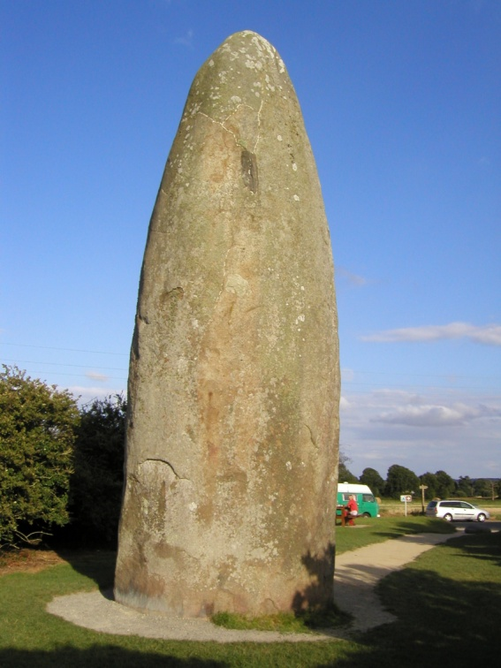
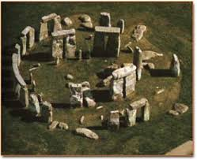
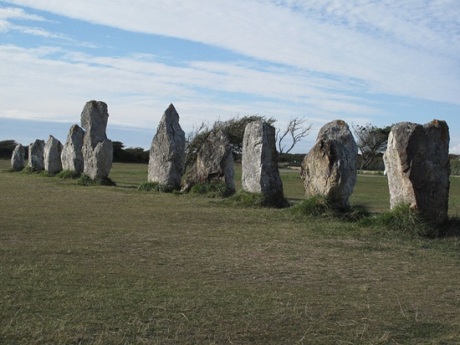
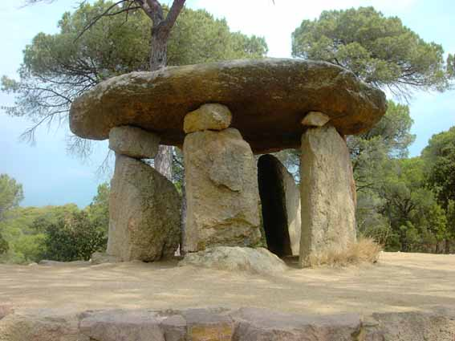
2.3 Architecture and Art
Megalithic constructions
-Huge stone blocks (megaliths) were used as collective tombs or sanctuaries
1. Menhirs – large stones stuck into the ground
2. Cromlech – menhirs in a circle
3. Alignment – menhirs in a line
4. Dolmens – several vertical stone walls + hortizontal one laid across top

Slide 5
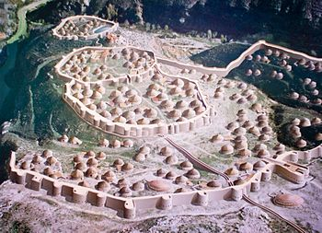
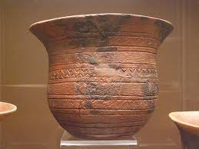
Part 3: The Metal Age in Spain
-Copper Age 300oBC
-Millares culture (village in Almería w/dwelling remains), inhabitants grew cereal, raised livestock, made copper tools + jewelry with a necropolis near the village.
-Bell Beaker culture – made bell-shaped ceramics w/geometric designs, remains in center/periphery of peninsula

Slide 6
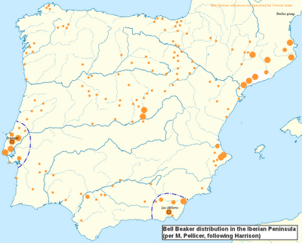

Slide 7
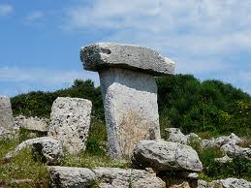
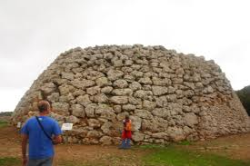
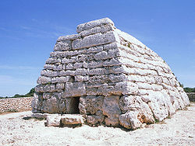
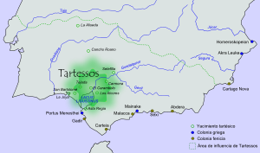
-Bronze Age 1800BC
1
-El Argar culture: settled areas easily defendable, buried dead at home w/possessions, made bronze objects + ceramics
-Talaiotic culture: in Balaeric Islands, Typical constructions: 1. Taula (2 flat stones in shape of a table), 2. Naveta (shaped like upturned boat), 3. Taliot (circular/elliptical stone tower)
-Tartesso culture/kingdom: SW peninsula, made jewelry +traded w/others
3
2

Slide 8
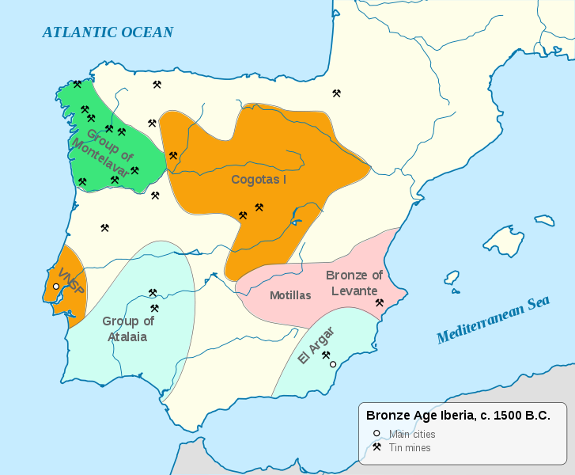

Slide 9
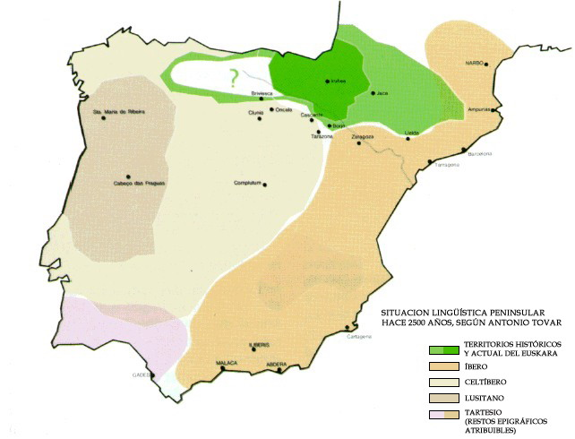
-Iron Age 750BC
Iberians – in Levante + Andalucía
Celts – mixed in North Peninsula
http://www.history.com/shows/mankind-the-story-of-all-of-us/videos/mankind-the-story-of-all-of-us-iron-age (3min)

