Slide 1
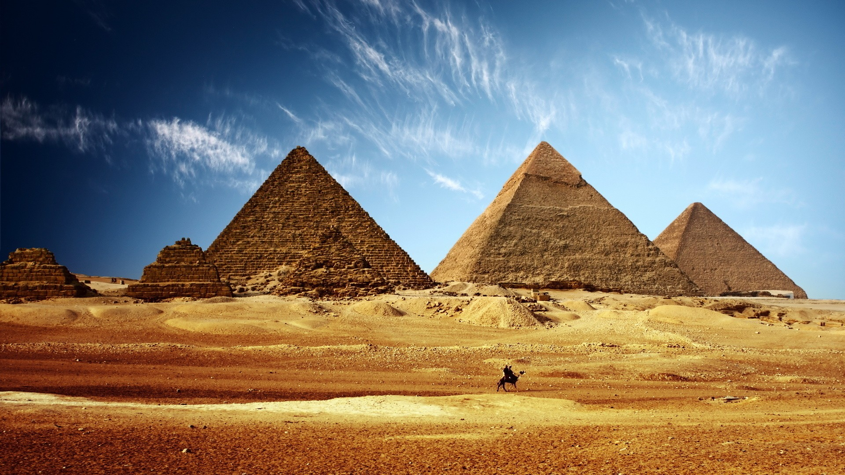
Part 4: Egypt Natural Environment and History

Slide 2
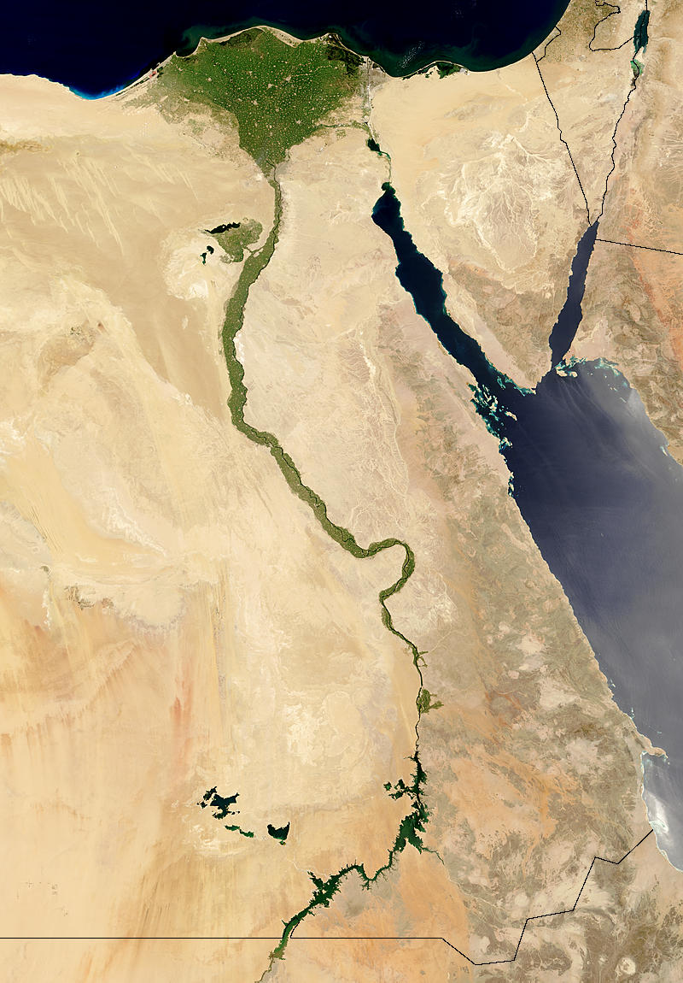
4.1 The Natural Environment
Egypt = a big desert with the Nile River crossing North to South
The Nile:
-flows from Lake Victoria to the Med. Sea
-has a big delta at its mouth
-flooded once per year in Ancient times, fertilizing the banks
-was worshipped by the people because it was a source of life + the main transport route

Slide 3
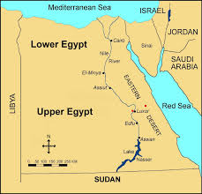
LOWER Egypt = North: delta= flat, marshy area
UPPER Egypt = South: Nile River Valley = got the Nile’s floods

Slide 4
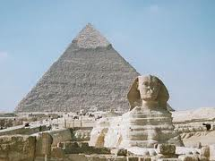
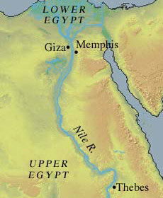
4.2 The History of Egypt
-3100BC Upper + Lower Egypt were united by King Menes
Periods:
1. THE OLD KINGDOM = 2700-2200BC
-Time of splendor, Pyramids built by Pharaohs, capital of empire = Memphis
2. THE MIDDLE KINGDOM = 2052 – 1786BC
-capital moved to Thebes
-territory increased
-1786BC The Hyksos invaded Egypt → moved capital to Avaris (it stayed there almost 200 years)

Slide 5
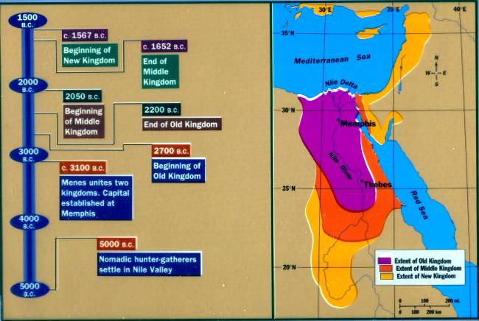
3. THE NEW KINGDOM = 1567 – 1085BC
-Huge prosperity
-capital moved to Thebes
-Pharaohs ruled (ex. Akhenaten, Tutankhamun, Ramses II and III)

Slide 6
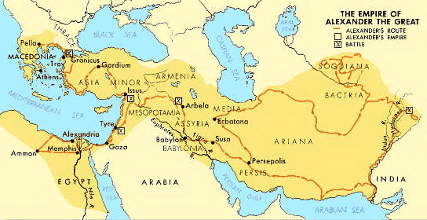
4. THE LATE PERIOD = 1085-30BC
-time of decline
- Egypt disintegrates into small, independent states
-invaded by Ethiopians, Assyrians + Persians
-332BC Alexander the Great conquers Egypt
-Rome rules Egypt after Cleopatra dies

Slide 7
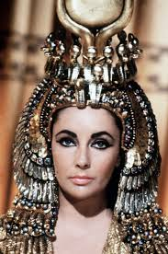
Cleopatra (wikipedia)
Cleopatra originally ruled jointly with her father, Ptolemy XII Auletes, and later with her brothers, Ptolemy XIII and Ptolemy XIV, whom she married as per Egyptian custom, but eventually she became sole ruler.
As pharaoh, she consummated a liaison with Julius Caesar that solidified her grip on the throne. She later elevated her son with Caesar, Caesarion, to co-ruler in name.
After Caesar's assassination in 44 BC, she aligned with Mark Antony in opposition to Caesar's legal heir, Gaius Julius Caesar Octavianus (later known as Augustus).
With Antony, she bore the twins Cleopatra Selene II and Alexander Helios, and another son, Ptolemy Philadelphus (her unions with her brothers had produced no children).
After losing the Battle of Actium to Octavian's forces, Antony committed suicide. Cleopatra followed suit, according to tradition killing herself by means of an asp bite on August 12, 30 BC.^{[13]} She was briefly outlived by Caesarion, who was declared pharaoh by his supporters but soon killed on Octavian's orders. Egypt became the Roman province of Aegyptus.
http://www.youtube.com/watch?v=OlQIZrwTF7U 6min story, fill-in-the blanks
http://www.youtube.com/watch?v=dvmAHCieXRI (4 min, National Geographic biography)
http://www.youtube.com/watch?v=OlQIZrwTF7U (fill in the blank activitiy, 6min)
http://www.youtube.com/watch?v=B_UK_m0c3Kw (horrible hisoties, 5min)

Slide 8
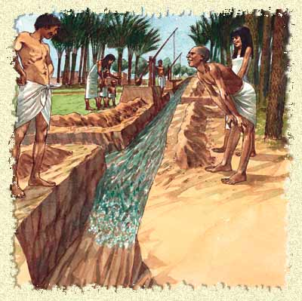
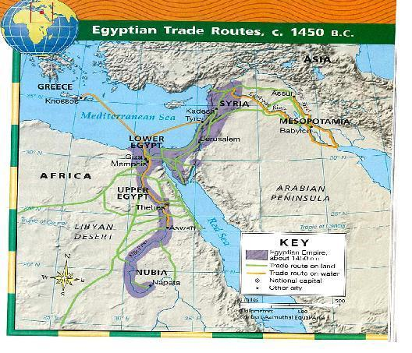
Part 5: Life and Culture in Egypt
5.1 The Economy
AGRICULTURE
-built dams+canals w/Nile water
-cereals (for bread + beer)
-flax (clothing)
-grapes, onions, lentils, peas
LIVESTOCK
-cows, sheep, goats, pigs, ducks, geese, + chickens
-fished from Nile
CRAFTWORK
-pottery, metalwork, jewelry+ fabric making
TRADE
-w/Mesopotamia, Greece etc.
-sold agricultural produce + craftwork
-bought wood, metals + slaves

Slide 9
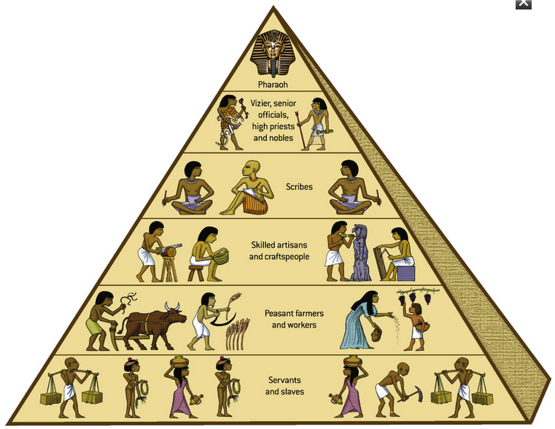
5.2 Society
HIERARCHY:
1. PHARAOH + his family
- king/god
-owned all land + people
-held absolute power
2. RULING CASTE
-priests
-vizier (head of public of public administration)
-important public servants ex. provincial governors, military commanders, treasurers + scribes
3.OTHER FREE PEOPLE
-soldiers
-craft workers
-workers
-farmers
-foreigners
4. SLAVES
-worked in mines
-did domestic chores

Slide 10
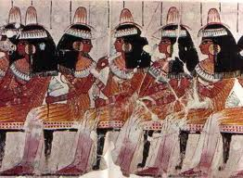
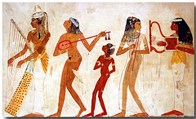
Role of Women:
They:
- had greater freedom than in other civilizations.
-could walk the streets freely
-could own property w/their husbands
-had the same legal rights as men
- Were depicted as larger in art

Slide 11
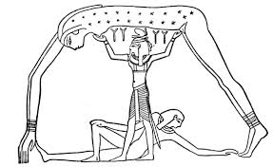
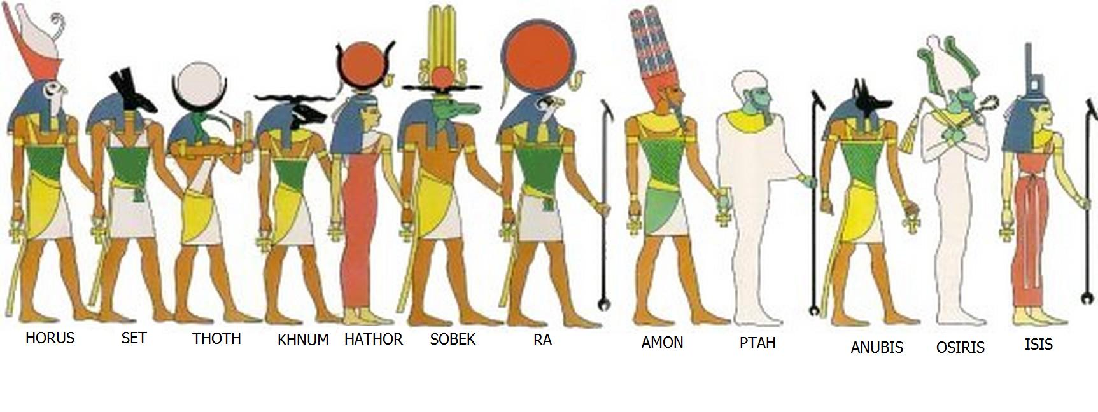
5.3 Religion
-polytheists (believed in many gods)
-zoomorphic gods (w/ human + animal aspects)
-believed in life after death and mummified the dead
The Egyptian God Shu holding up the sky (Nut)

Slide 12
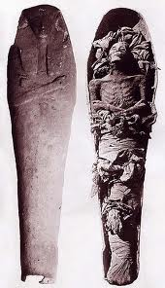
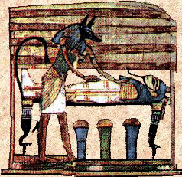
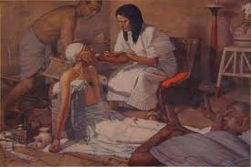
5.4 Arts and Sciences
-written texts preserved on papyrus (plant) + inscribed on temple/tomb walls
- ex. The Book of the Dead (religious)
-Understood basic math and could calculate volumes of cylinders + pyramids
-Advanced medicine: performed surgeries, understood fractures + other problems

Slide 13
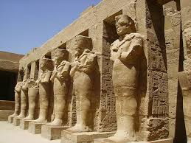
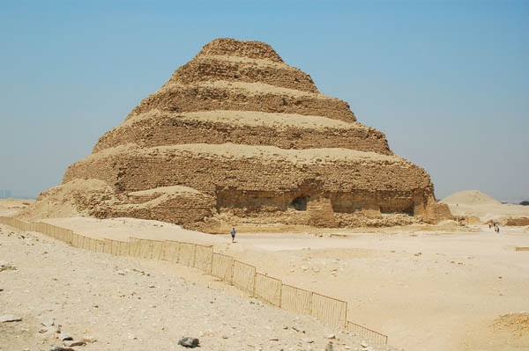
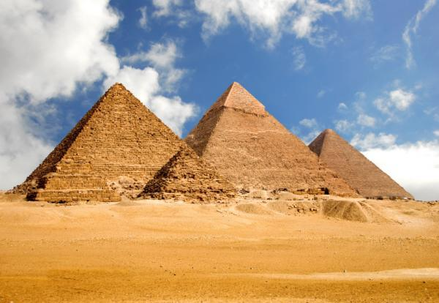
5.5 Architecture + Art
ARCHITECTURE:
-TEMPLES:
-religious buildings, dedicated to gods, where priests lived
-rock temples (ex: Abu Simbel temples)
-parts: shrine, open courtyard, avenue lined with stone sphinxes
-tombs
-MASTABAS
-for pharaohs + important public servants
-flat topped pyramids
-PYRAMIDS
-tombs for the pharaoh and his family
-formed a labyrinth of rooms/passageways
-corpse surrounded by treasure
-HYPOGEA (1 hypogeum)
-underground tombs carved out of rock
-had various passageways leading to funerary chamber of pharaoh

Slide 14
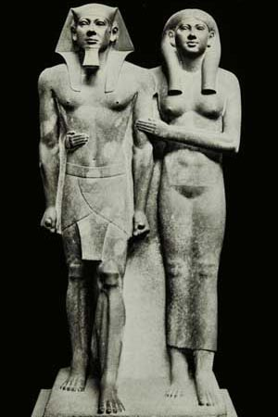
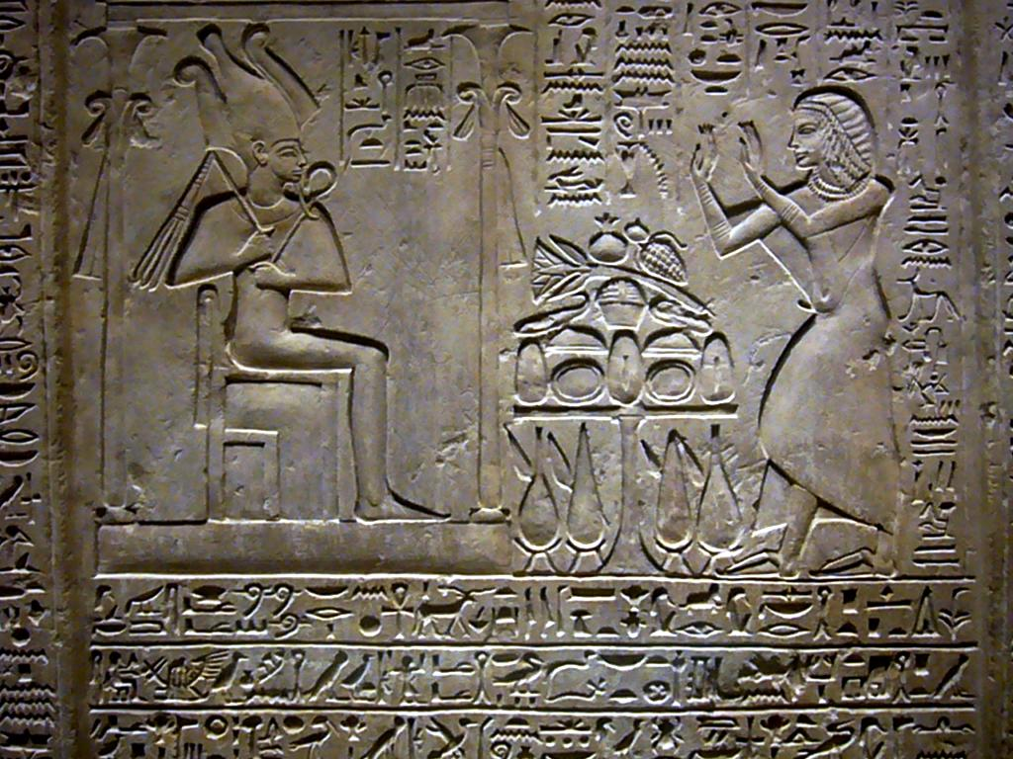
SCULPTURE
- Was for religious + funerary purposes
-pharaoh + family had an idealized depiction: younger + bigger looking than they really were.
-faces were static and inexpressive, looking straight ahead
-depictions of nobles and civil servants were more realistic
-reliefs in wood + stone

Slide 15
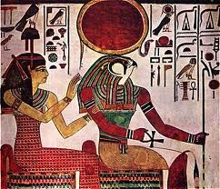
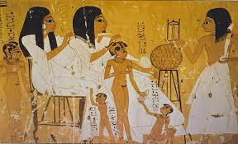
PAINTING
-used to worship the gods + for decoration
-techniques:
1. Tempera: paint diluted w/egg yolk or glue
2. fresco: paint dissolved in water + applied to a wet plaster wall
-subjects of paintings: gods + humans
-more important figures were depicted as larger

